Slide 1
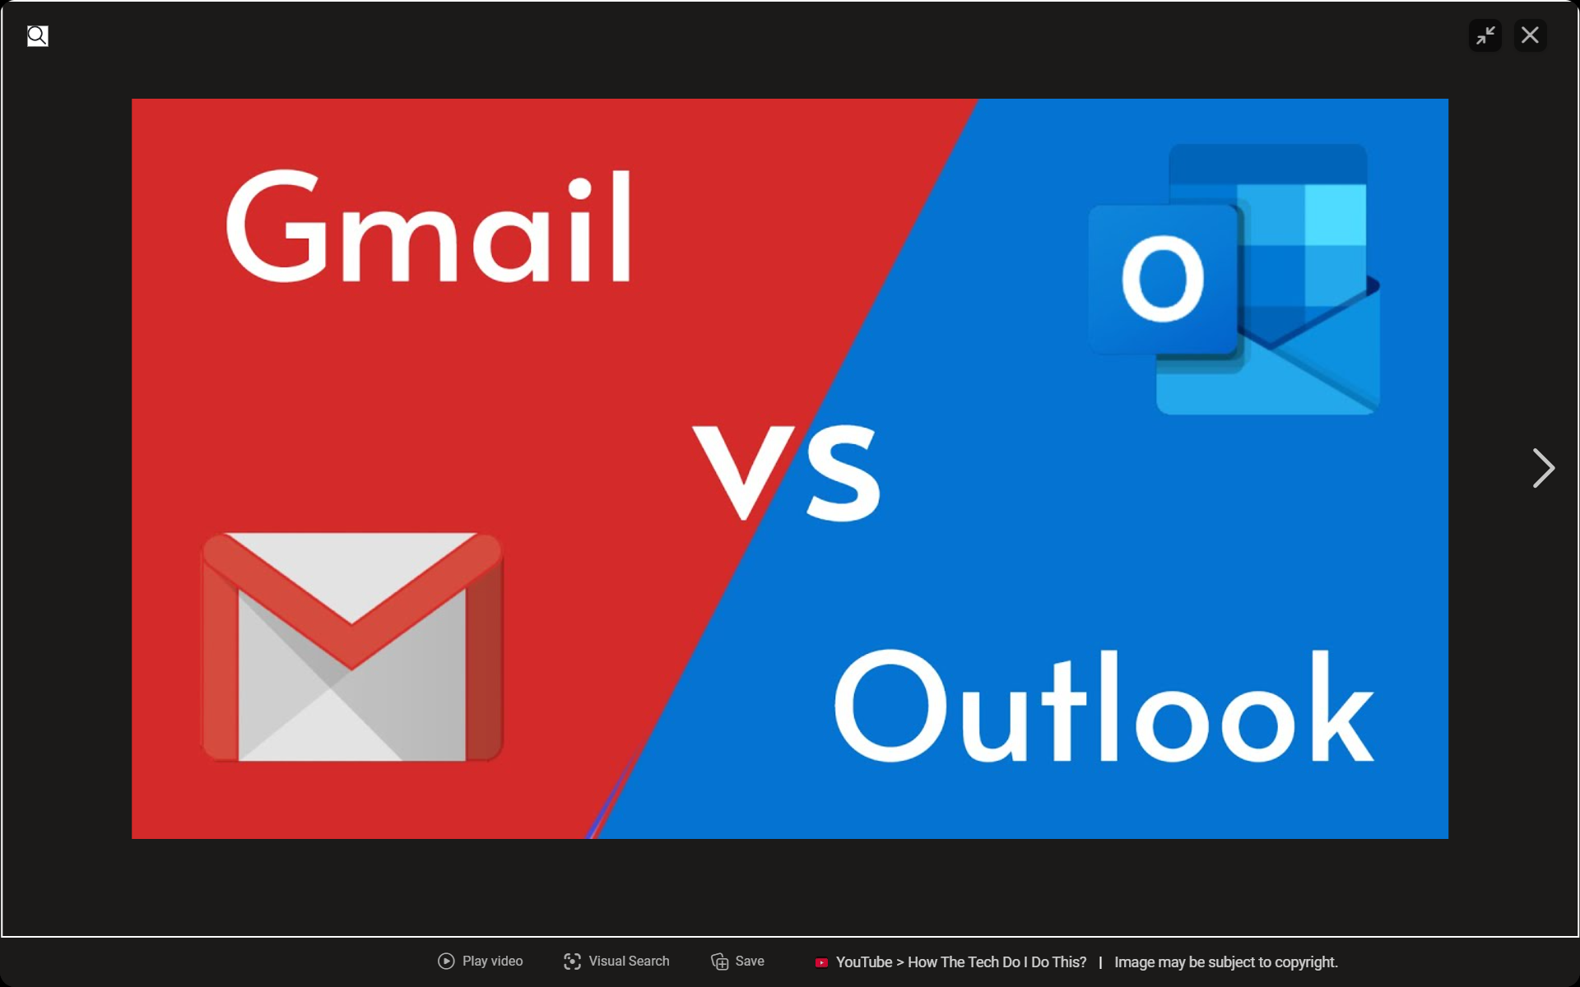



Slide 2
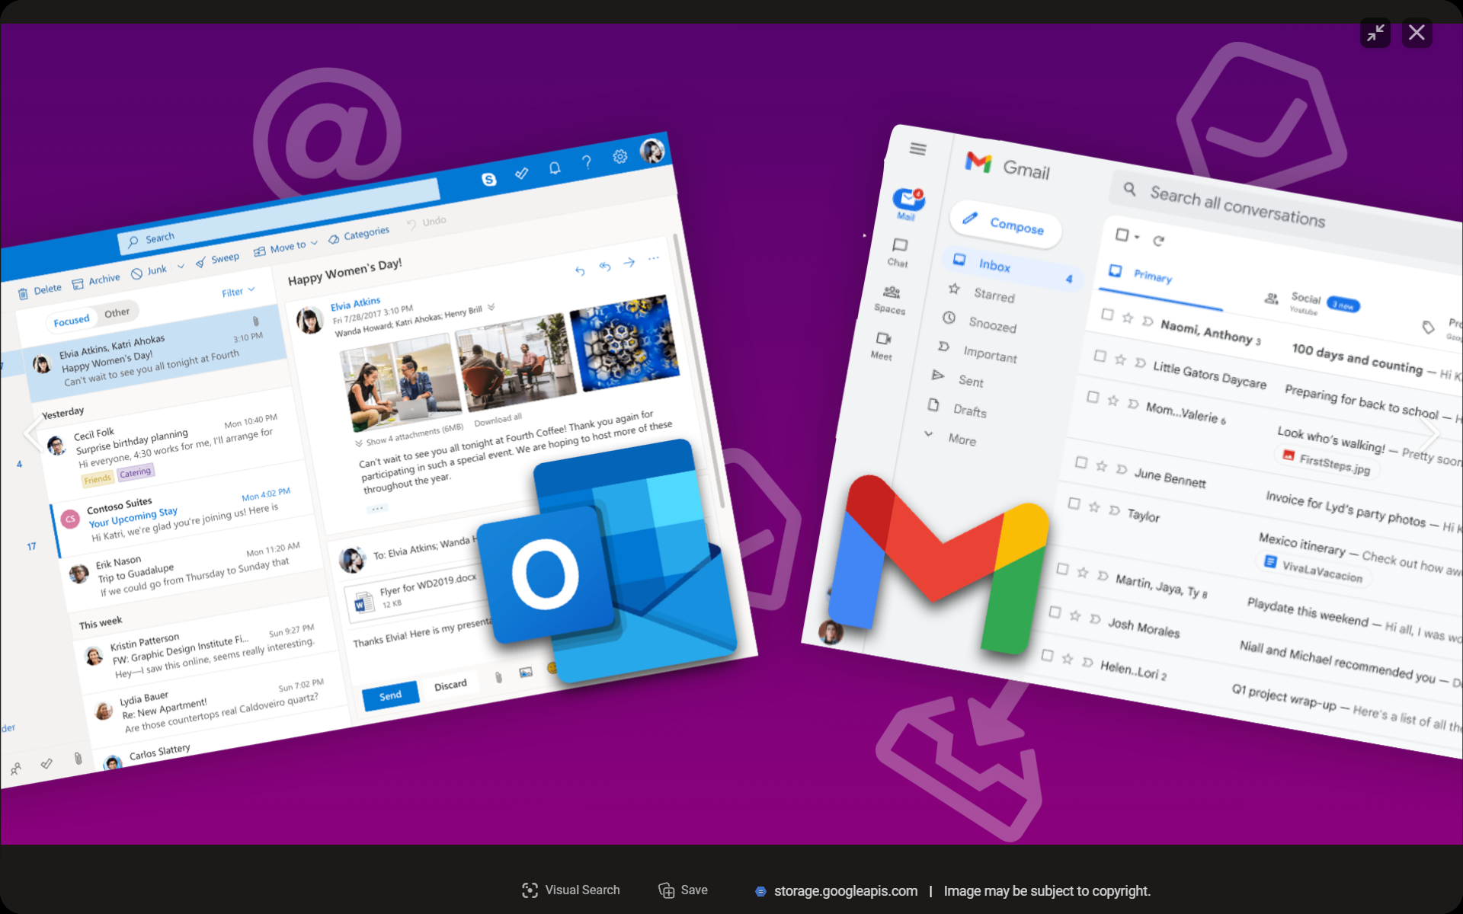

Slide 3
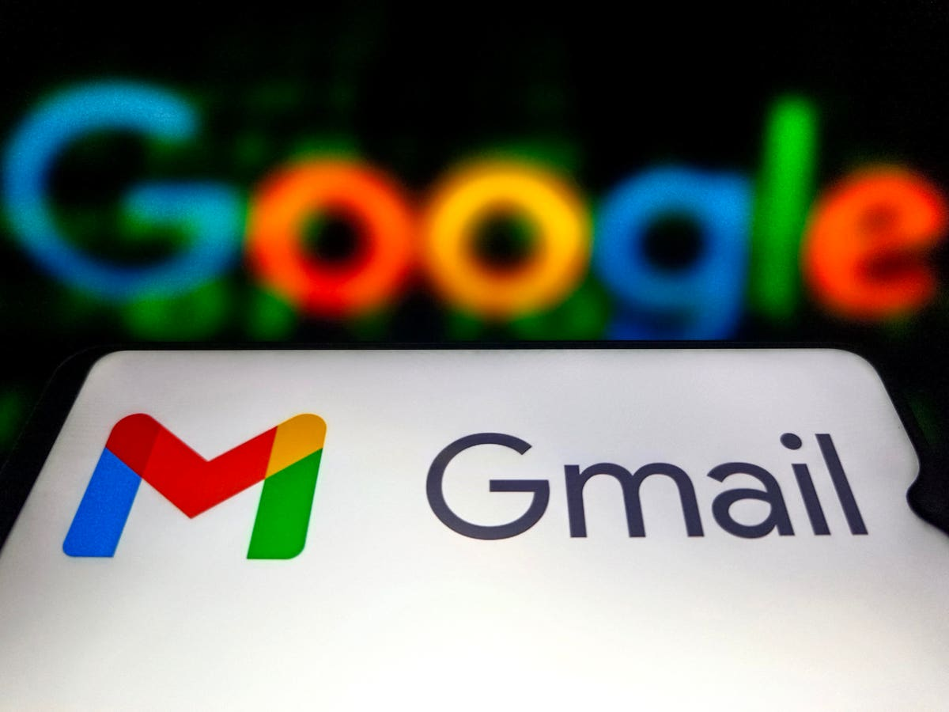
Introduction to G-mail :
Created by Google
Free email service
Easy to send and receive emails
Used by millions of people worldwide

Slide 4
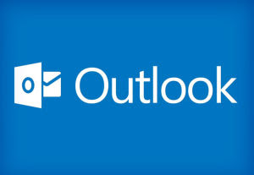
Introduction to outlook :
Microsoft Outlook is an email and personal information management application.
Developed by Microsoft.
Used to send and receive emails.
Helps manage daily communication and work.
Available on Windows, Mac, web, and mobile devices.

Slide 5
Gmail :
🔴 Uses Google colors – Red, Blue, Yellow, and Green in the logo.
⚪ White background – Makes the interface clean and easy to read.
🎨 Simple and modern design – Bright colors with good contrast for better visibility.
Outlook :
🔵 Blue and White Theme – Gives a clean, professional, and modern look.
⚪ Simple Interface – Uses light colors with clear icons for easy navigation.
🌙 Dark Mode Available – Reduces eye strain and provides a comfortable viewing

Slide 6
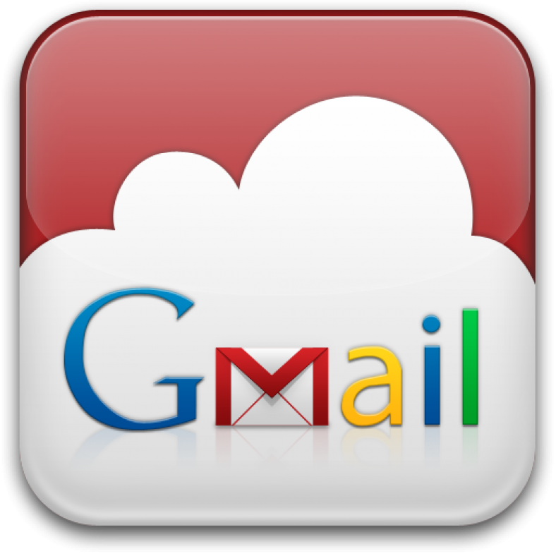

LOGO & branding
GMAIL:
Colorful "M" logo, modern Google branding, simple design.

Slide 7
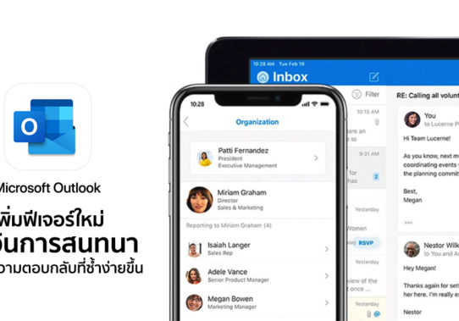
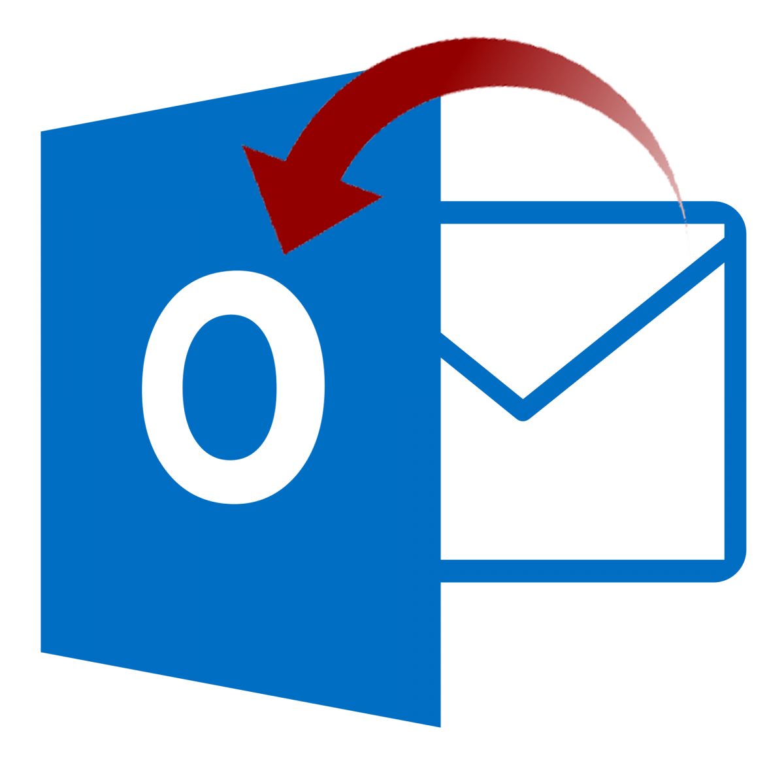
Outlook:
Blue "O" and envelope logo, professional Microsoft branding, clean design.

Slide 8
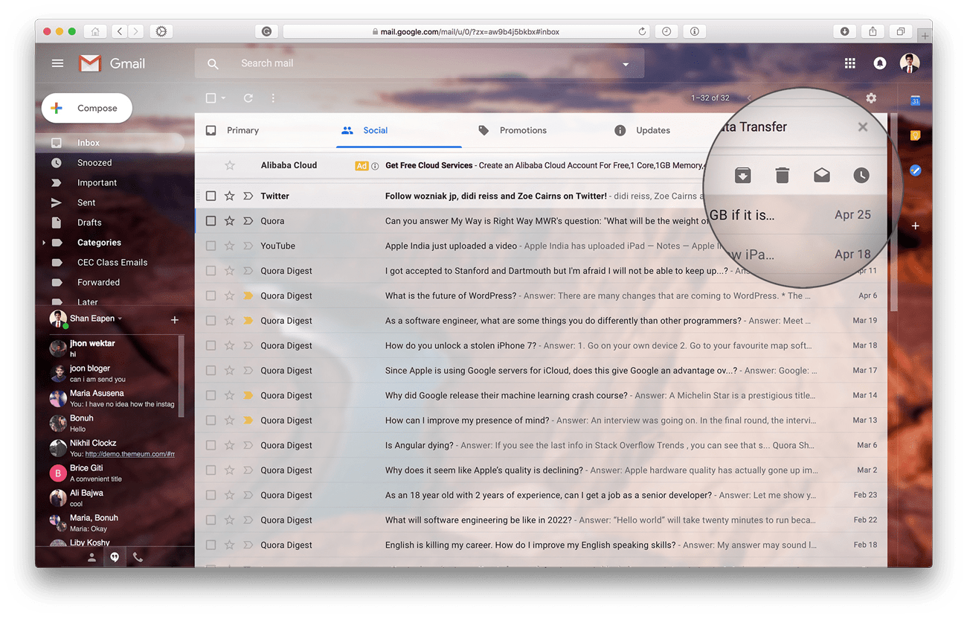
Strengths of Gmail :
Easy Email Management – Organizes emails with folders, filters, and categories.
Built-in Calendar – Schedule meetings, set reminders, and manage appointments.
Strong Security – Protects emails with spam filtering and security features.

Slide 9
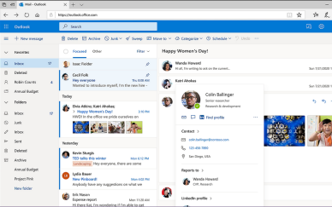
Strengths of Outlook :
📅 Built-in Calendar – Easily schedule meetings and manage appointments.
🔗 Microsoft Office Integration – Works seamlessly with Word, Excel, Teams, and OneDrive.
🔒 Strong Security – Advanced spam filtering and email protection.
📂 Email Organization – Folders, categories, and rules help keep emails organized.
This Photo by Unknown Author is licensed under CC BY-SA

Slide 10
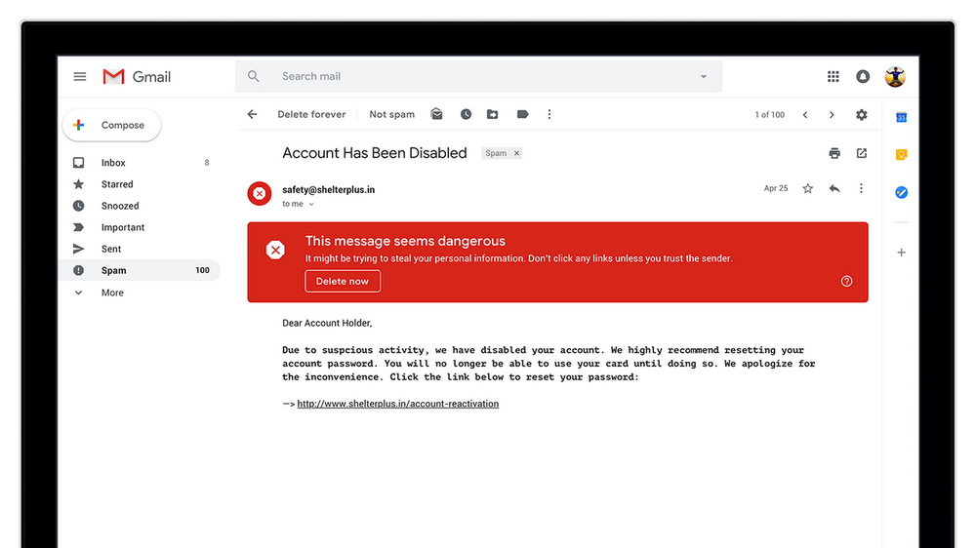
Weaknesses of Gmail :
❌ Limited Free Storage – Shared with Google Drive and Photos.
❌ Internet Required – Most features need an internet connection.
❌ Privacy Concerns – Some users worry about Google collecting data.
This Photo by Unknown Author is licensed under CC BY-NC

Slide 11
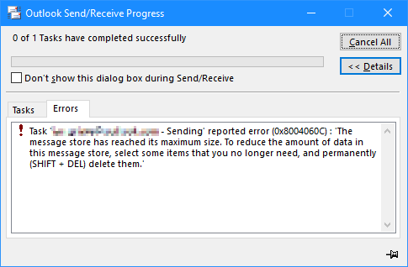
Weaknesses of Outlook :
❌ Can Be Complex – More features make it harder for beginners.
💰 Paid Features – Many advanced features require a Microsoft 365 subscription.
🖥️ Uses More System Resources – Can be slower on older computers.

Slide 12
Typography in Gmail :
Simple and clear fonts – Gmail uses easy-to-read fonts for all users.
Good font size – Text is readable on both mobile and desktop.
Bold headings – Important emails and labels stand out clearly.
Neat text layout – Proper spacing makes emails easy to read.
Typography in Outlook :
Clear and readable fonts make emails easy to read.
Different font sizes help highlight headings and important text.
Bold, Italic, and Underline are used to emphasize key information.
Consistent text style gives emails a neat and professional look.

Slide 13
COMPARISON OF GMAIL AND OUTLOOK :
Feature | Gmail | Outlook
Color | Uses a simple white and red color theme. | Uses a clean blue and white color theme.
Buttons | Buttons are simple and easy to find. | Buttons are clear and provide more options.
Navigation | Easy to use with a simple side menu. | Well-organized with folders and menu options.
Fonts | Uses clean and easy-to-read fonts. | Uses professional and readable fonts.
Layout | Simple and clean layout. | Structured layout with more features.
Icons | Uses simple and colorful icons. | Uses professional and clear icons.
Overall | Best for simple and quick email use. | Best for professional and business email use.

Slide 14
Conclusion :
Outlook is a reliable tool for email, calendar, and task management.
It improves communication, organization, and productivity.
It is widely used by businesses, students, and professionals.

